Slide 1


BUSINESS INTELLIGENCE
Blinkit Sales Performance Analysis
Transforming raw transactional data into actionable business insights through comprehensive Excel analytics

Slide 2

PROJECT SCOPE
End-to-End Analytics Workflow
01
Requirement Gathering
Identified stakeholder needs and defined key business questions
02
Data Preparation
Cleaned and standardized 8,523 records across 12 features
03
Analysis & Insights
Applied pivot tables and Excel functions for KPI computation
04
Dashboard Creation
Built interactive visualizations for data-driven decisions

Slide 3
Key Performance Indicators
8.5K
12
4
Total Records
Data Features
Core KPIs
Item-level sales data analyzed
Comprehensive attribute coverage
Sales, items, ratings, averages
Primary Metrics
Analysis Dimensions
Total Sales Revenue
Product Performance
Average Sales per Transaction
Outlet Characteristics
Number of Items Sold
Customer Preferences
Average Customer Rating
Geographic Patterns

Slide 4

DATA STRUCTURE
Dataset Categories
Product Attributes
Item type classification and fat content segmentation for health-driven analysis
Sales Metrics
Revenue values, quantity sold, and average sales per transaction
Customer Feedback
Item ratings and aggregated satisfaction scores across products
Outlet Details
Store type, size, location tier, and establishment year data

Slide 5

Data Cleaning & Preparation
Quality Assurance
Missing Value Treatment
Removed inconsistencies, duplicate entries, and formatting issues to ensure data integrity
Handled incorrect and missing values to maintain analytical accuracy across all records
Standardization
Custom Calculations
Unified categorical fields for consistent grouping and aggregation across dimensions
Created calculated columns to support KPI computation and advanced segmentation

Slide 6

ANALYSIS
Multi-Dimensional Segmentation
Analysis Techniques
Item Type Performance
Product category sales contribution
Applied advanced Excel functions and pivot tables to uncover patterns across multiple business dimensions.
Fat Content Preferences
Customer health-driven choices
Pivot table summarization
Outlet Characteristics
KPI calculations
Size, location, and type impact
Comparative analysis
Trend identification
Temporal Patterns
Outlet age vs. performance

Slide 7




Key Analytical Outcomes
Top Performers
Identified high-performing product categories and outlet formats
Customer Insights
Analyzed preferences based on fat content and ratings
Location Impact
Evaluated outlet size, age, and geography on sales
The comprehensive analysis enabled creation of an interactive Excel dashboard that empowers stakeholders to make informed, data-driven business decisions across product strategy, outlet management, and sales optimization.

Slide 8
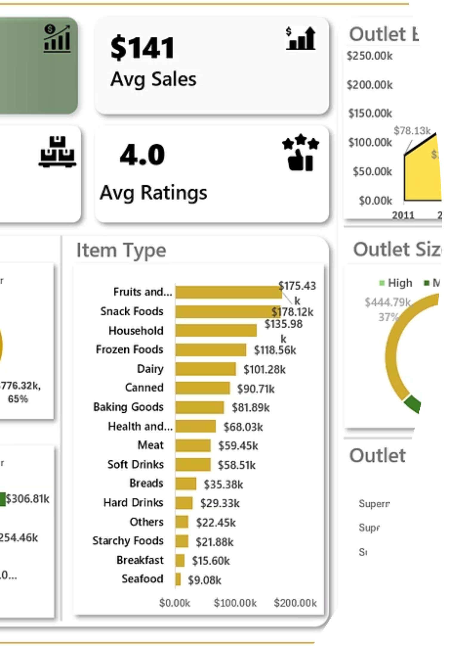
VISUALIZATION
Interactive Excel Dashboard
A comprehensive visual interface presenting all key insights through dynamic charts, filters, and KPI summaries for real-time business intelligence.
Visual Elements
Interactivity
Accessibility
Filters and drill-down capabilities
User-friendly navigation
Charts, graphs, and KPI cards

Slide 9

STRATEGIC RECOMMENDATIONS
Data-Driven Action Plan
1
Product Optimization
Prioritize high-performing products and fat-content categories to maximize revenue through targeted promotions
2
Inventory Strategy
Optimize product assortment based on outlet size and performance metrics for efficient stock management
3
Regional Customization
Apply location-specific sales strategies using outlet tier insights to capture local market opportunities
4
Quality Enhancement
Improve low-rated products and outlets to boost customer satisfaction and long-term retention

Slide 10

Project Impact & Next Steps
Immediate Value
Decision Support
Actionable insights for product strategy, outlet management, and sales optimization
Interactive dashboard enabling real-time, data-driven business decisions
Continuous Improvement
Framework for ongoing performance monitoring and strategic refinement
"Transforming data into insights, insights into action, and action into sustainable business growth."

